Slide 1

Stochastic Process in Cricket
Members:
Shimoni Adani - A024
Jaskirat Singh Chadha - A028 Dhruvi Gandhi - A039
Muskan Kothari - A041
Malhar Khatu - A043
Pooja - A046
Mentor:
Prashant Dhamale
Project Coordinator:
Lily Polekad

Slide 2
Introduction
Stochastic processes are used in mathematical models and phenomena that appear to vary in random manner.
Stochastic models are used in sports to predict outcomes of games based on past events. It is useful in strategy planning.
In the project, we have used Markov chains and Weiner Process to analyse data and predict the outcome of a game or multiple games based on the previous data.
Basic rules and regulations of cricket are taken into consideration.

Slide 3
Problem Statement
Approach 1
To predict the match outcome against a particular opponent given the previous match result using Markov chains.
Approach 2
To predict the match outcome during the course of the 2nd innings using Weiner Process.

Slide 4
Approach 1
Markov Chains in Cricket

Slide 5
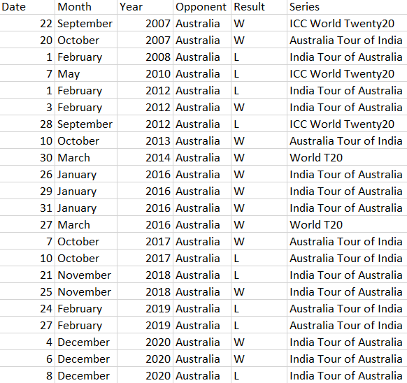
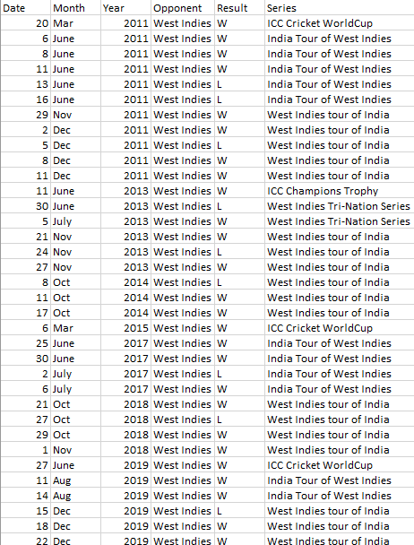
Data Description
T20 and ODI against Australia and West Indies respectively
T20 – 22 matches, ODI – 35 matches
T20 Series
ODI Series

Slide 6
Data Inconsistency
Some matches had to be excluded from the data because of following reasons –
Match abandoned without a ball bowled
No result due to rains or similar reasons
Tie between the teams

Slide 7
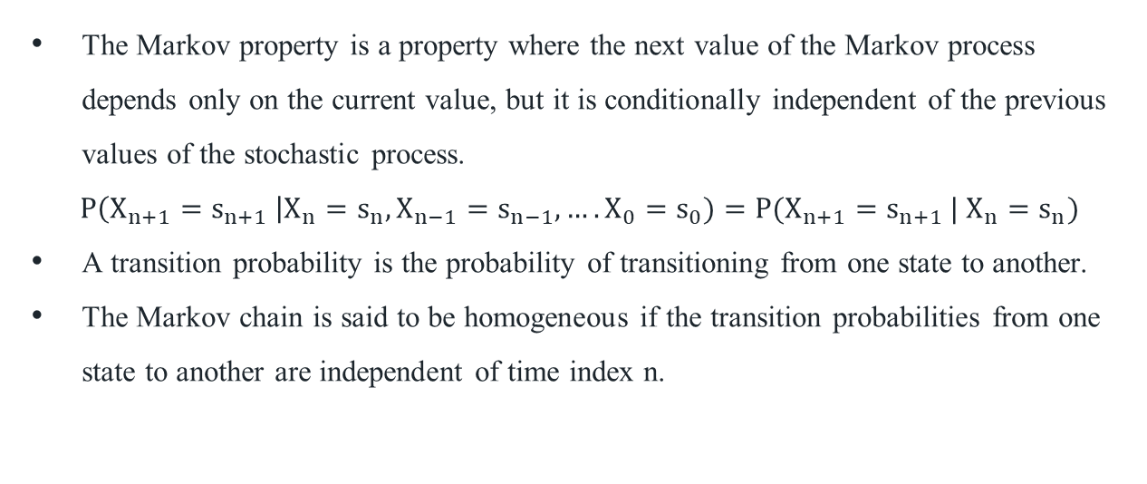
Methodology
The Markov property is a property where the next value of the Markov process depends only on the current value, but it is conditionally independent of the previous values of the stochastic process.
$P\left(X_{n+1}=s_{n+1} \right|X_{n}=s_{n}, X_{n−1}=s_{n−1},….X_{0}=s_{0})=P(X_{n+1}=s_{n+1} | X_{n}=s_{n})$
A transition probability is the probability of transitioning from one state to another.
The Markov chain is said to be homogeneous if the transition probabilities from one state to another are independent of time index n.
Notes:
Explanation for the equation= the probabilities at the current time, depend only on the most recent known state in the past, even if it’s not exactly one step before.

Slide 8
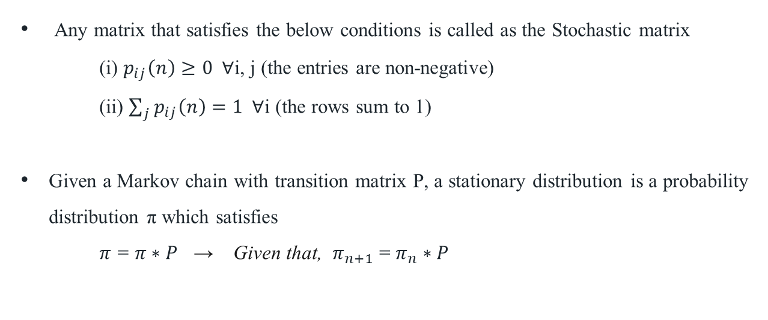
Methodology
Any matrix that satisfies the below conditions is called as the Stochastic matrix
(i) $p_{ij}\left(n\right)≥0$ ∀i, j (the entries are non-negative)
(ii) $\sum_{j}{p_{ij}\left(n\right)}=1$∀i (the rows sum to 1)
Given a Markov chain with transition matrix P, a stationary distribution is a probability distribution π which satisfies
$π$= $π∗P$ → Given that, $π_{n+1}$ = $π_{n}∗P$

Slide 9
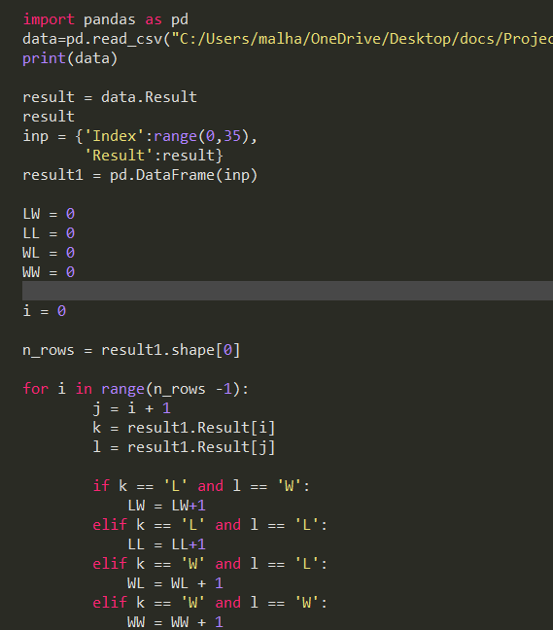
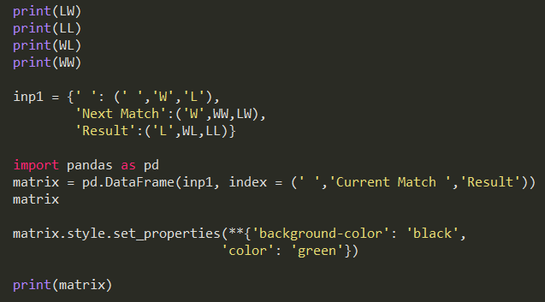
Data Analysis
Software used – Python
Step 1: Import the Dataset
Step 2: Find the required values
Step 3: Form the matrix

Slide 10


Data Analysis
Output:
For T20Is For ODIs

Slide 11
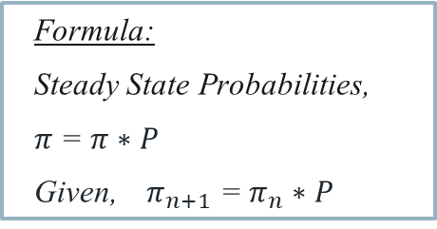
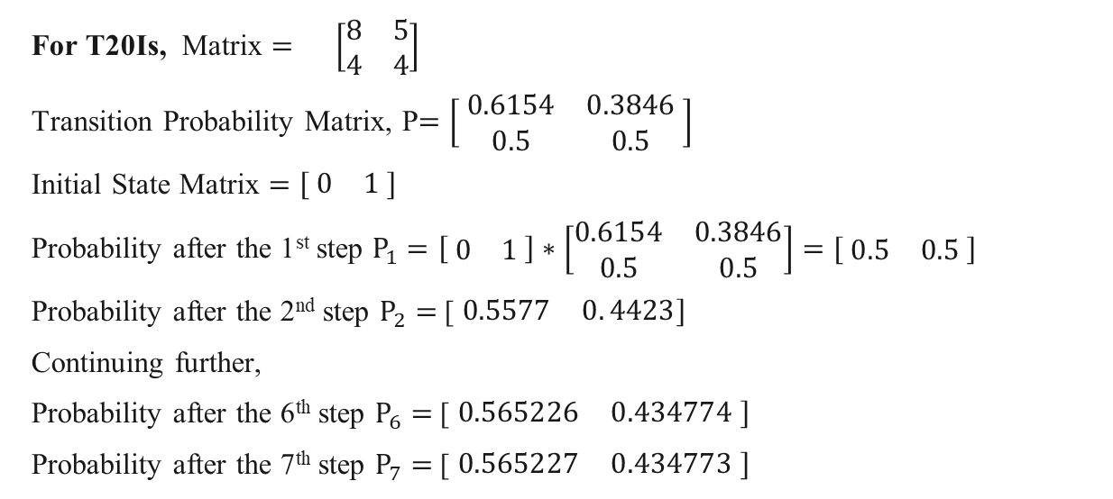


Data Analysis
$$W L$$
Formula:
Steady State Probabilities,
$π$= $π∗P$
Given, $π_{n+1}$ = $π_{n}∗P$
For T20Is, Matrix $= \left[\begin{matrix}8 & 5 \\ 4 & 4\end{matrix}\right]$
Transition Probability Matrix, P$=\left[ \begin{matrix}0.6154 & 0.3846 \\ 0.5 & 0.5\end{matrix} \right]$
Initial State Matrix $=\begin{matrix}[ 0 & 1 ]\end{matrix}$
Probability after the 1st step $P_{1}=\left[ \begin{matrix}0 & 1\end{matrix} \right]∗\left[\begin{matrix}0.6154 & 0.3846 \\ 0.5 & 0.5\end{matrix}\right]=[ \begin{matrix}0.5 & 0.5\end{matrix} ]$
Probability after the 2nd step $P_{2}=$ [ $\begin{matrix}0.5577 & 0. 4423]\end{matrix}$
Continuing further,
Probability after the 6th step $P_{6}=$ [ $\begin{matrix}0.565226 & 0.434774 ]\end{matrix}$
Probability after the 7th step $P_{7}=$ [ $\begin{matrix}0.565227 & 0.434773 ]\end{matrix}$
$$W$$
L

Slide 12
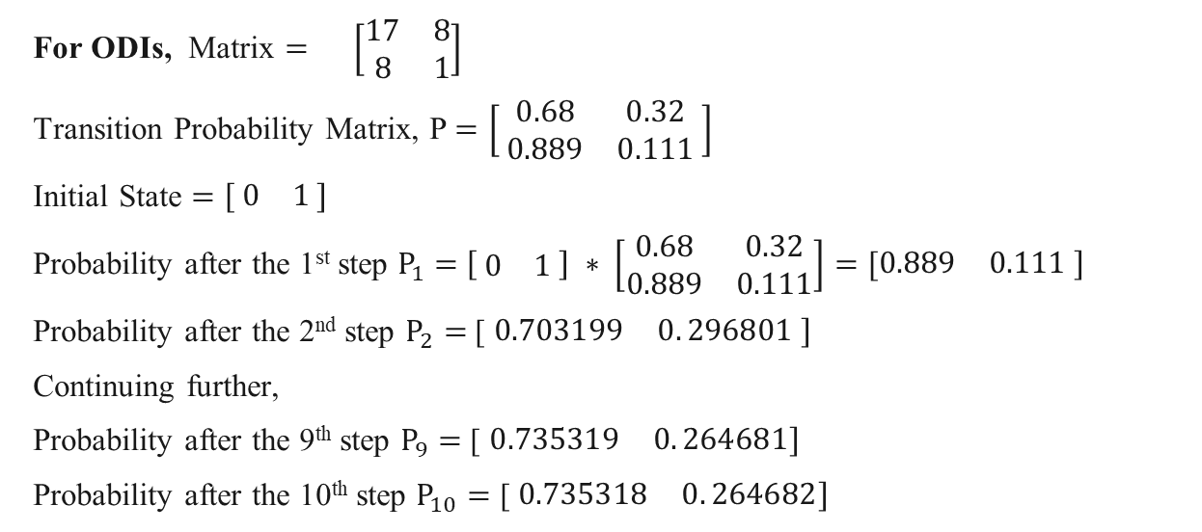


Data Analysis
$$W L$$
Formula:
Steady State Probabilities,
$π$= $π∗P$
Given, $π_{n+1}$ = $π_{n}∗P$
For ODIs, Matrix $= \left[\begin{matrix}17 & 8 \\ 8 & 1\end{matrix}\right]$
Transition Probability Matrix, P $=\left[ \begin{matrix}0.68 & 0.32 \\ 0.889 & 0.111\end{matrix} \right]$
Initial State $=\begin{matrix}[ 0 & 1 ]\end{matrix}$
Probability after the 1st step $P_{1}=$ $\left[ \begin{matrix}0 & 1\end{matrix} \right] ∗ \left[\begin{matrix}0.68 & 0.32 \\ 0.889 & 0.111\end{matrix}\right]=[\begin{matrix}0.889 & 0.111 ]\end{matrix}$
Probability after the 2nd step $P_{2}=$ [ $\begin{matrix}0.703199 & 0. 296801 ] \end{matrix}$
Continuing further,
Probability after the 9th step $P_{9}=$ [ $\begin{matrix}0.735319 & 0. 264681]\end{matrix}$
Probability after the 10th step $P_{10}=$ [ $\begin{matrix}0.735318 & 0. 264682]\end{matrix}$
$$W$$
L

Slide 13


Result and Interpretation
For T20Is,
$Accuracy \%=100−[ | \frac{TV−OV}{TV} |∗100$ ]
Here, TV = True Value
OV= Observed/Calculated Value
Therefore,
$Accuracy \%=100−\left[ \right| \frac{13−12.43}{13} |∗100$ ]
Real Outcome
Total matches= 22
Lost = 9
Calculated Outcome
Total matches= 22
Won = 13
Won = 12.43
Lost = 9.57
$$=95.62 \%$$

Slide 14


Result and Interpretation
For ODIs,
$Accuracy \%=100−[ | \frac{TV−OV}{TV} |∗100$ ]
Here, TV = True Value
OV= Observed/Calculated Value
Therefore,
$Accuracy \%=100−[ | \frac{26−25.74}{26} |∗100$ ]
Real Outcome
Total matches= 35
Lost = 9
Calculated Outcome
Total matches= 35
Won = 26
Won = 25.74
Lost = 9.26
$$=99 \%$$

Slide 15
Conclusion
For T20Is, we can conclude with 95.62 % accuracy that the probability of India winning the next match against Australia is 56.52%.
For ODIs, we can conclude with 99% accuracy that the probability of India winning the next match against West Indies is 73.53%.
Consistent to our prediction, India won the next ODI match against West Indies during the West Indies tour of India in February 2022.

Slide 16
Limitations
This model makes a prediction based on only one factor.
The number of matches played by India against these opponents are limited.
While using Markov Chain, we have assumed that the result of the next match depends only on the current match’s outcome, which may not be true.
Notes:
This model makes a prediction based on only one factor i.e. winning or losing in the previous match.
In order to apply these models, much of the published research uses parameters estimated from historical data, thereby ignoring the uncertainty of the parameter values and the most relevant information that arises during competition

Slide 17
Approach 2
Wiener Process in Cricket

Slide 18
Introduction
The new model focuses on finding the probability of winning the match based on the data points of the same match using the Wiener Process.
Wiener process is a variable whose value changes over a time in an uncertain way.
Usually represented by W_{t} , which is a linear combination of normal variables.

Slide 19
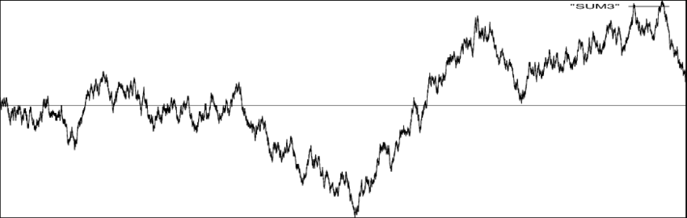
Weiner Process
W₀ = 0
With probability 1, the function t → W_{t} is continuous in t
The process (W_{t})_{t≥0+} has stationary, independent increments
The increment W_{t+s} − W_{s} = N (0, t)
A generalised Wiener process.

Slide 20
Data
Secondary data.
Ball to ball data.
2019 World Cup where India played in the second innings.
Historical data from year 1992 to 2015 where India played in the second innings in the World Cup. Value of the last ball of the second innings from 1992 to 2015.
Inconsistencies:
Wide balls, no balls and extras have been merged together.
Tied matches were not considered.

Slide 21
Methodology
Required Run Rate (RR)
X(t) = RR – NRR
where t=1,2,…,300
t=[1,300],t=(1/300,300/300),t=(0,1]
Net Run Rate (NRR)

Slide 22
Methodology
d$X_{t}$ = µdt + σd$W_{t}$
d𝑋_𝑡 = µdt + σd𝑊_𝑡
X(1) ~ N(µ, $σ^{2}$)
X(1) ~ N(µ, σ^2)
X(t) = µt + σ$W_{t}$ ≈ N(µt, $σ^{2}t$)
X(t) = µt + σ𝑊_𝑡 ≈ N(µt, σ^2 𝑡)

Slide 23
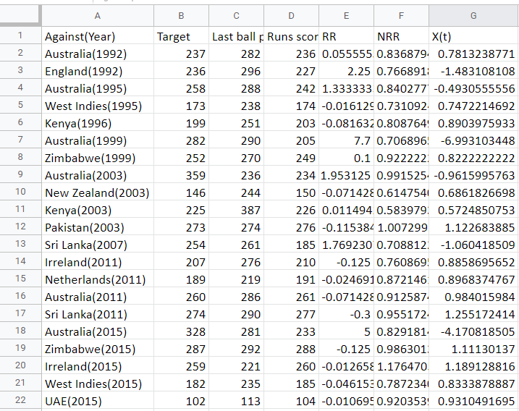
Methodology
P(X(1)|X($t_{1}$) = α) > 0
P(X(1)|X(𝑡_1) = α) > 0
(X(1)|X(t)= α) ~ N(μ * (1-${ t}_{1}$) + α, $σ^{2}$ * (1-${ t}_{1}$))
(X(1)|X(t)= α) ~ N(μ * (1-〖 𝑡〗_1) + α, 𝜎^2 * (1-〖 𝑡〗_1))
Mean (Calculated) and Variance (Calculated)
μ (Estimated) and $σ^{2}$ (Estimated)
μ (Estimated) and 𝜎^2 (Estimated)

Slide 24
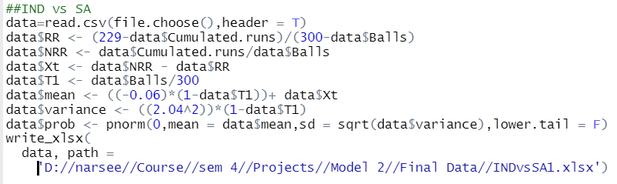
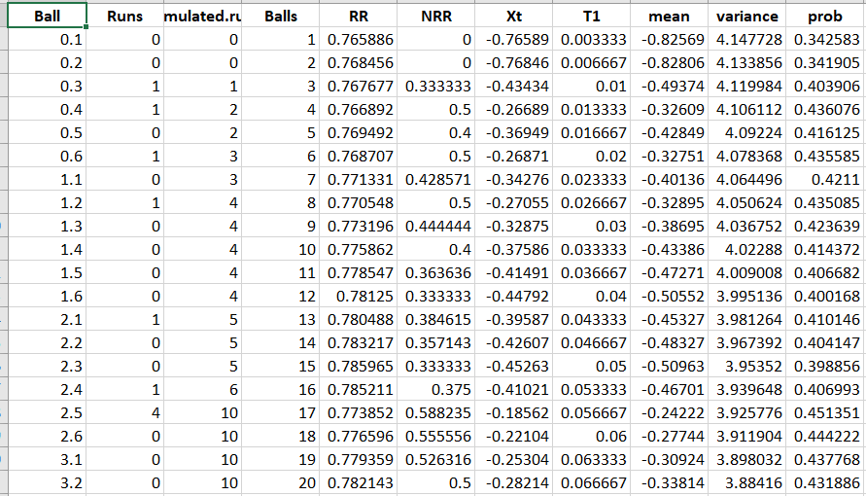
Data Analysis
Software used – R Studio
*229 being the target received

Slide 25
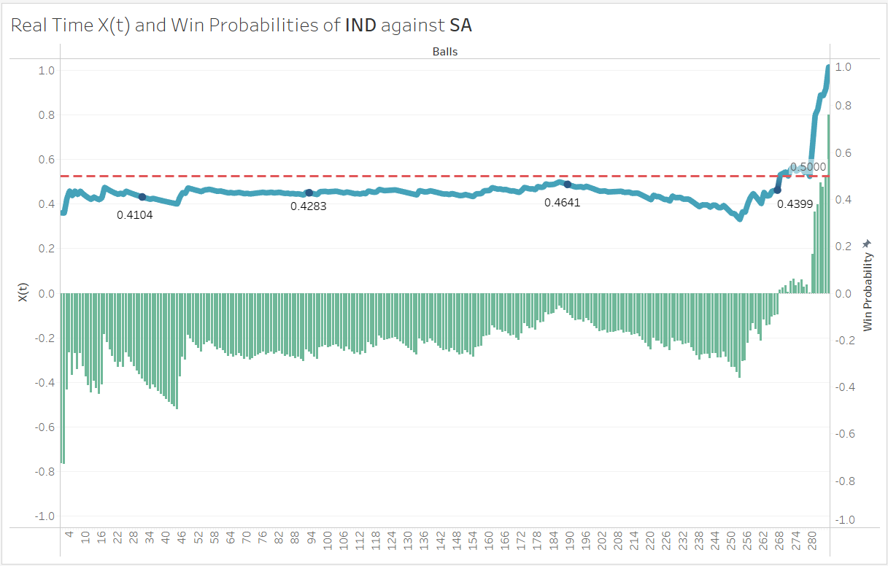
Results and Interpretation
Target: 229
Notes:
0-3 runs per over and wicket in 5th over; fluctuating and unsure model
Nrr fell drastically after the fifth over; 7th over acquired 15 runs, thus the sudden rise
X(t) declined around 190th ball; 10 runs in the over
Balls left were falling, runs were slow, until 42nd over of 14 runs, 44th over of 10 runs, 46th over of 10 runs Match turned, model prediction rised steeply

Slide 26
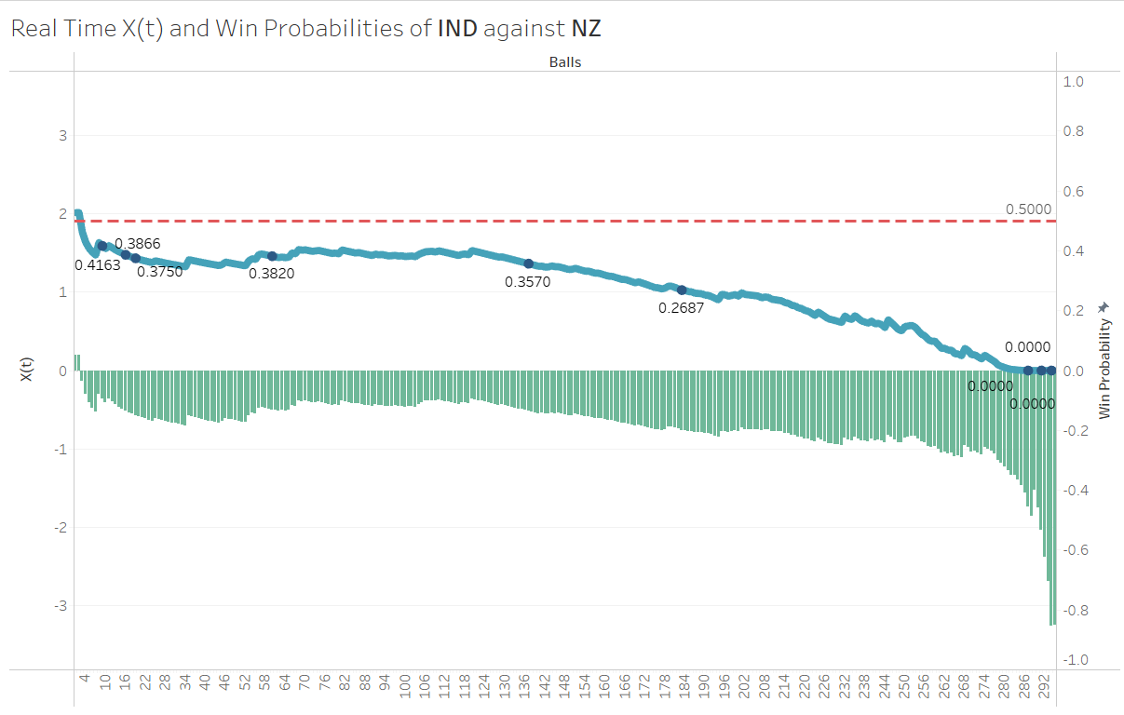
Results and Interpretation
Target: 240

Slide 27
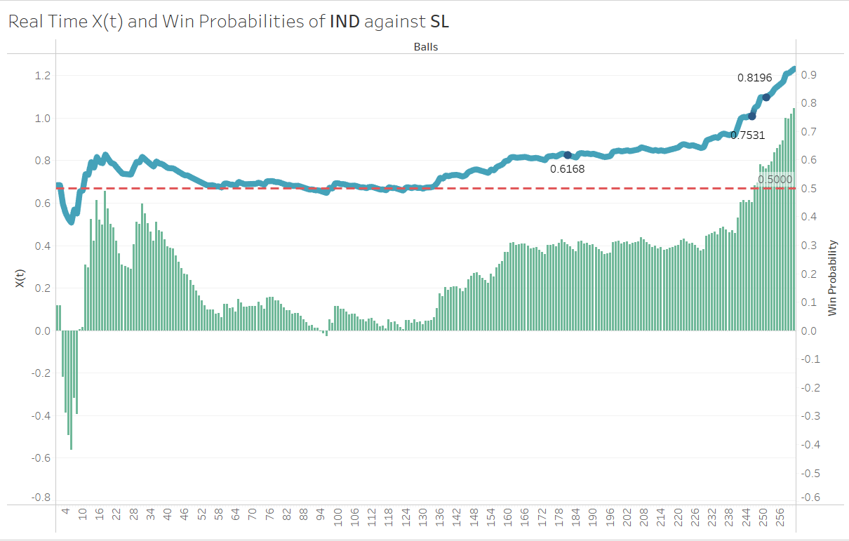
Results and Interpretation
Target: 265

Slide 28
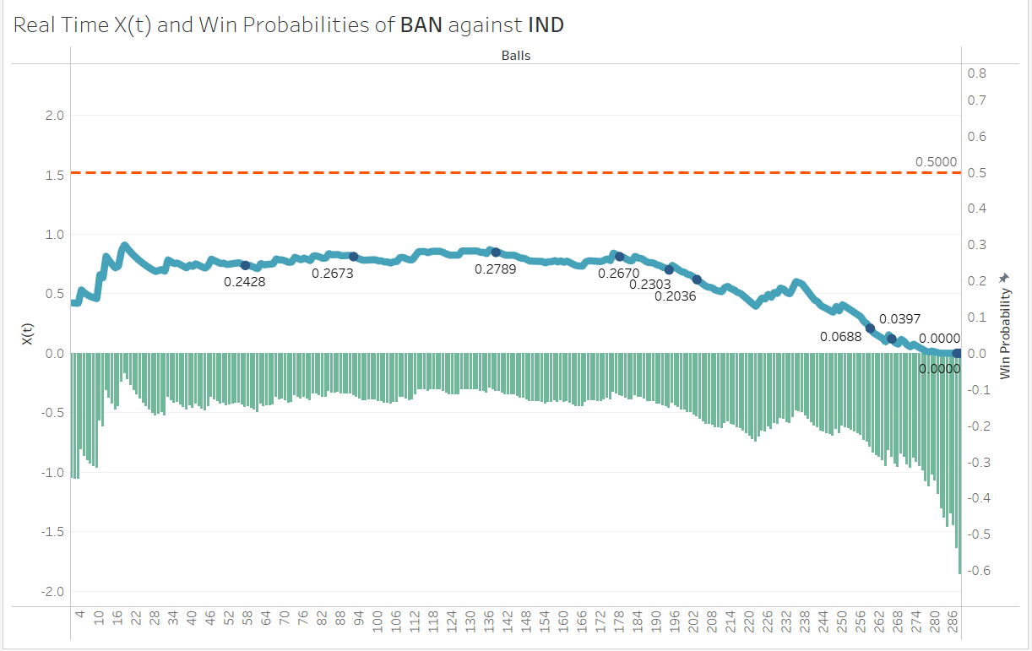
Results and Interpretation
Target: 315

Slide 29
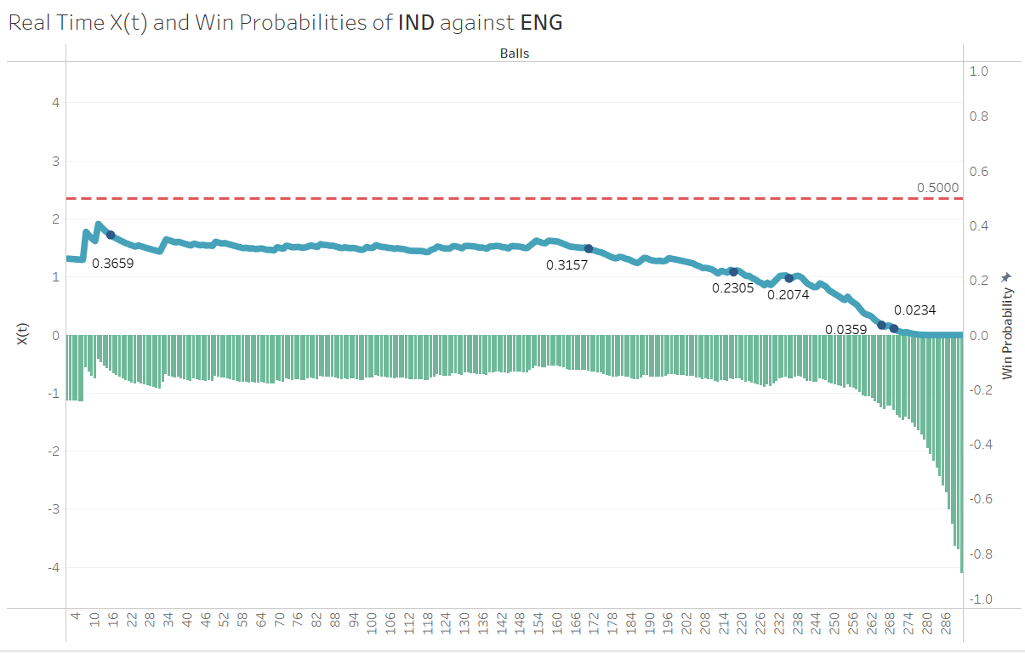
Results and Interpretation
Target: 315

Slide 30
Limitations
This model makes a prediction based on only one factor.
Impact of wickets are not taken into consideration directly.
Prediction cannot be made in first innings.

Slide 31
Future Scope
More variables can be considered in order to predict the outcome at an earlier stage of the match.
With an advanced model, prediction can be made in the first innings of the match.
Focus can also be put on looking at Markov chains objectively- finding/predicting the final game scores based on a few parameters.

Slide 32
Citation
Approach 1: Colwell, D., Jones, B., & Gillett, J. (1991). 75.7 A Markov Chain in Cricket (MCC!). The Mathematical Gazette, 75(472), 183–185. https://doi.org/10.2307/3620249
Approach 2: Kumar, Santosh. (2019). Stochastic differential theory of cricket. Stochastic Differential Theory in Cricket

Slide 33
Thankyou!!

